Slide 1



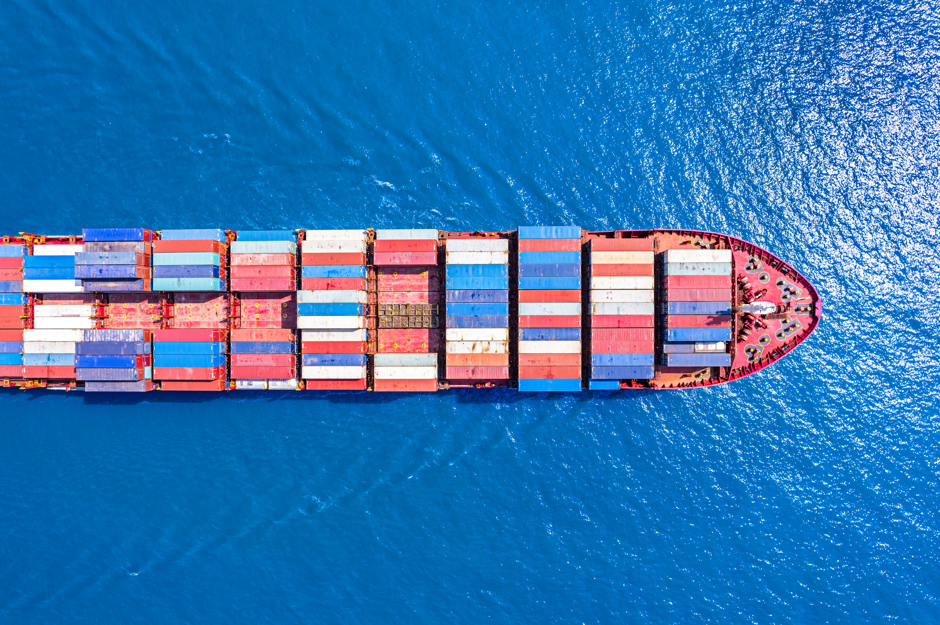


TRANSBORDER FREIGHT
ANALYSIS
A Data-Driven Review of U.S. Trade with Canada & Mexico
By
Barbara Addo

Slide 2


02
Introduction
Transportation systems are the backbone of modern economies, enabling trade, mobility, and connectivity across borders. However as transportation systems expand, they face increasing challenges, from congestion to environmental sustainability.

Slide 3



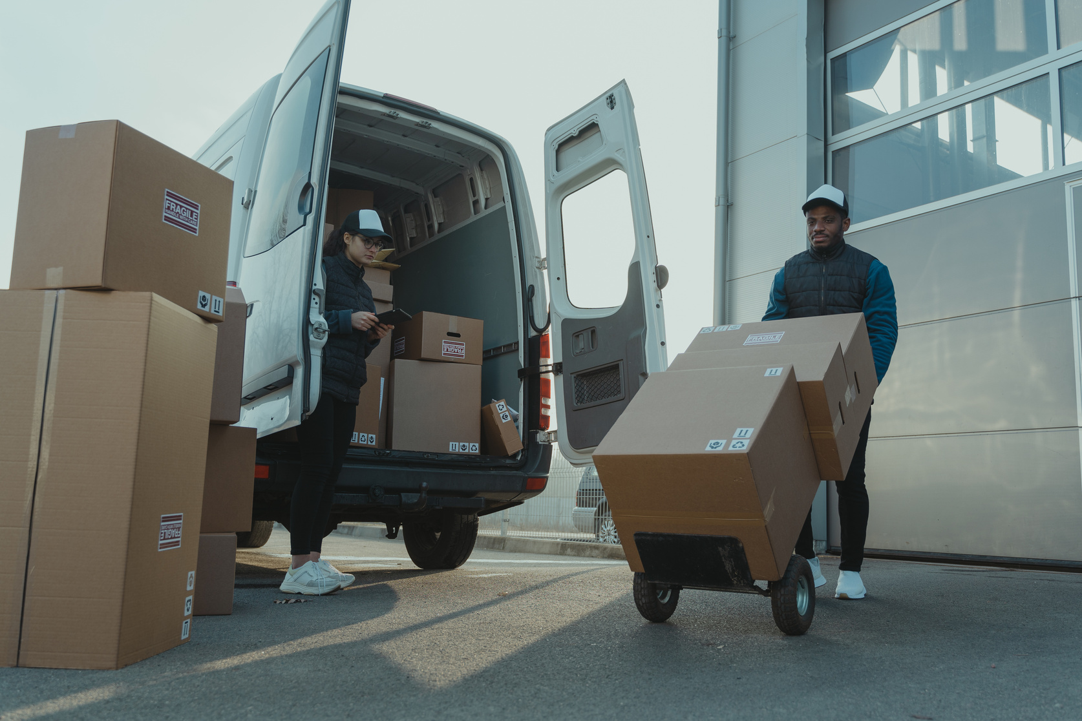
03
Objectives
Analyze transborder freight movement between the U.S., Canada, and Mexico (2020–2024).
Identify regional inefficiencies and modal differences.
Understand environmental impacts by transportation mode

Slide 4
04
Methodology (CRISP-DM FRAMEWORK)
Business Understanding : Addressed BTS needs for insights on freight efficiency and emissions.
Data Understanding : Monthly ZIP files (dot1 CSVs) from BTS covering freight type, value, weight, and mode.
Data Preparation : Combined, cleaned, and mapped 60+ CSVs (4 million records).
Modeling : Grouped by time, region, and transport mode for analysis.
Evaluation : Generated visual insights across 8 core questions.
Deployment : Recommendations structured for strategic use by BTS.

Slide 5
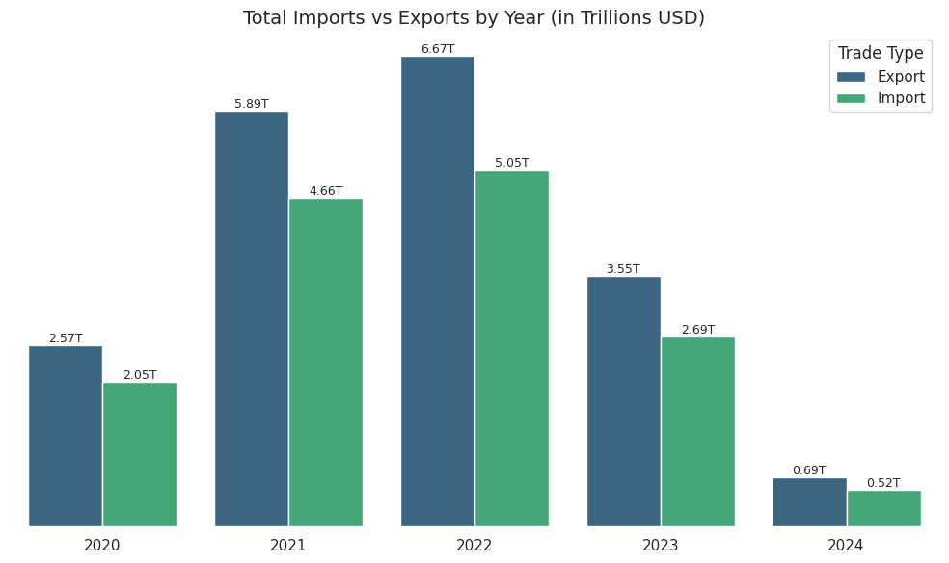
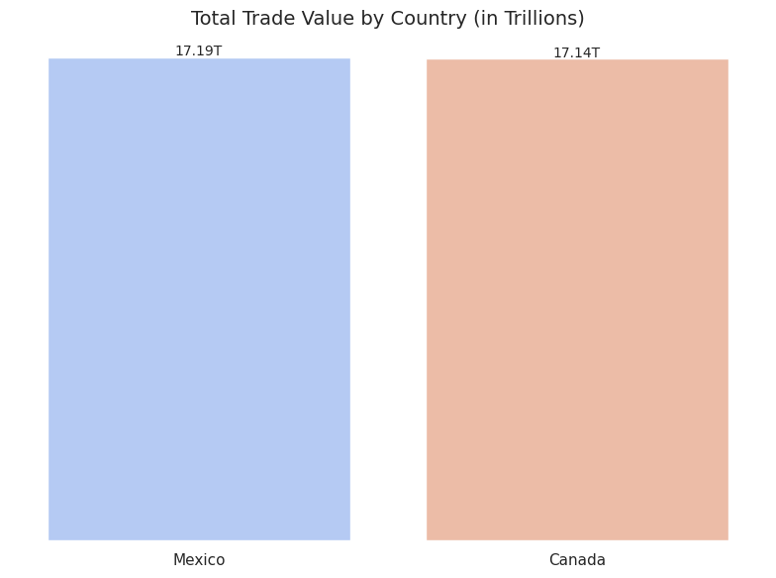
05
Key Insights
Trade Trends
U.S. exports consistently exceeded imports (2020–2024), peak in 2022 but declined sharply post 2022.
The U.S. recorded nearly equal trade with Mexico ($17.19T) and Canada ($17.14T), reflecting balanced and deeply integrated supply chain relationships.

Slide 6
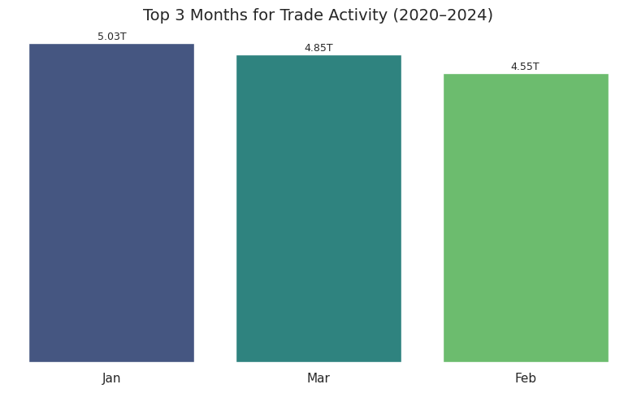
05
Seasonal Trade Patterns
Trade volumes were highest in January, March, and February, indicating strong post-holiday economic activity and inventory replenishment cycles.

Slide 7
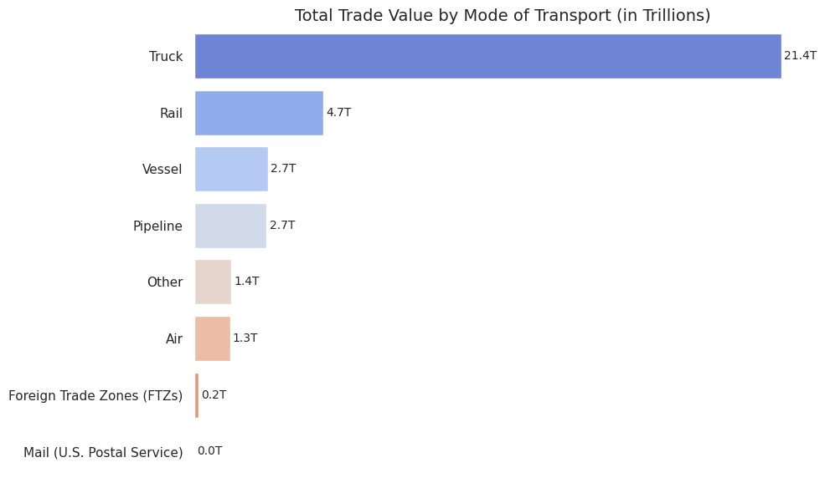
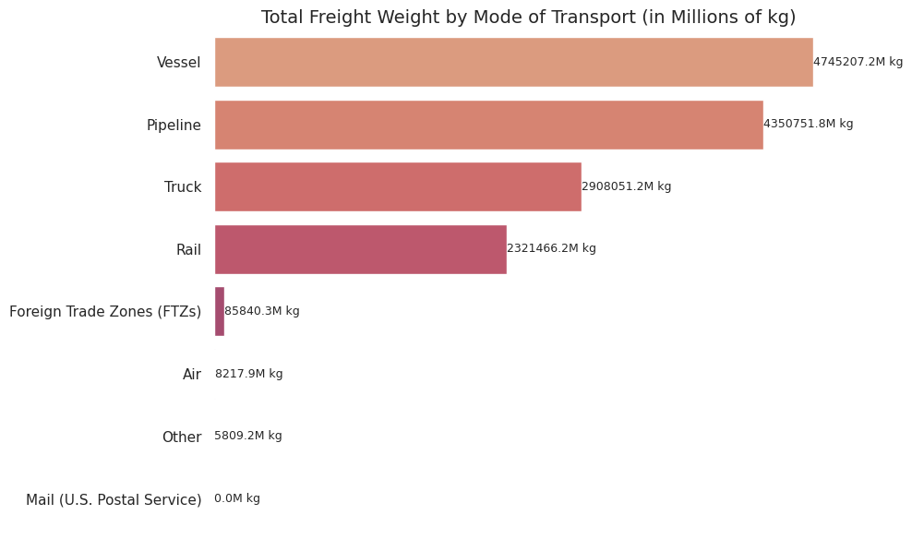
06
Transport Modes
Trucks handled over $21.4T in trade, dominating all modes.
Vessel carried the most by weight, indicating low-value bulk goods.

Slide 8
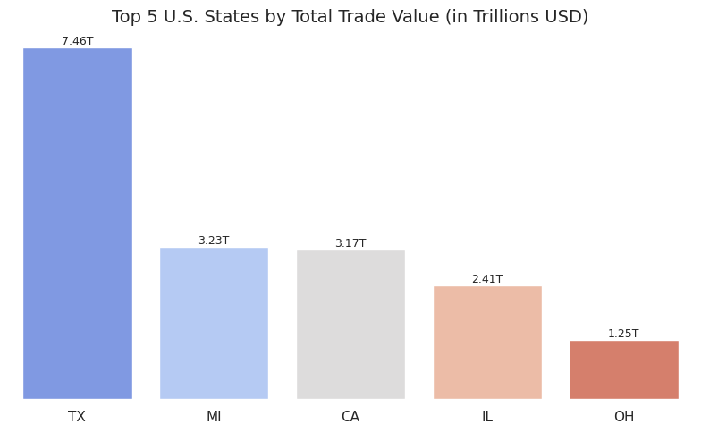
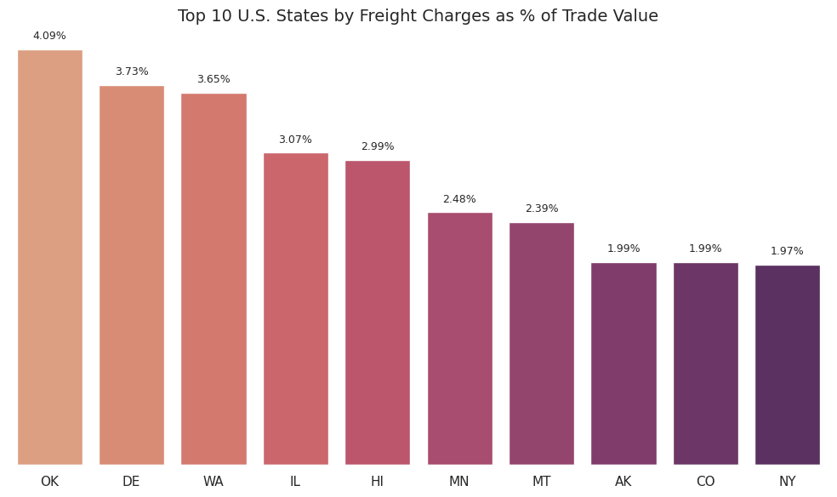
07
Texas emerged as the leading trade state ($7.46T), followed by Michigan and California highlighting regional trade hubs.
Oklahoma and Delaware show high freight charges each exceeding 3.5% suggesting potential inefficiencies.
Regional Overview

Slide 9
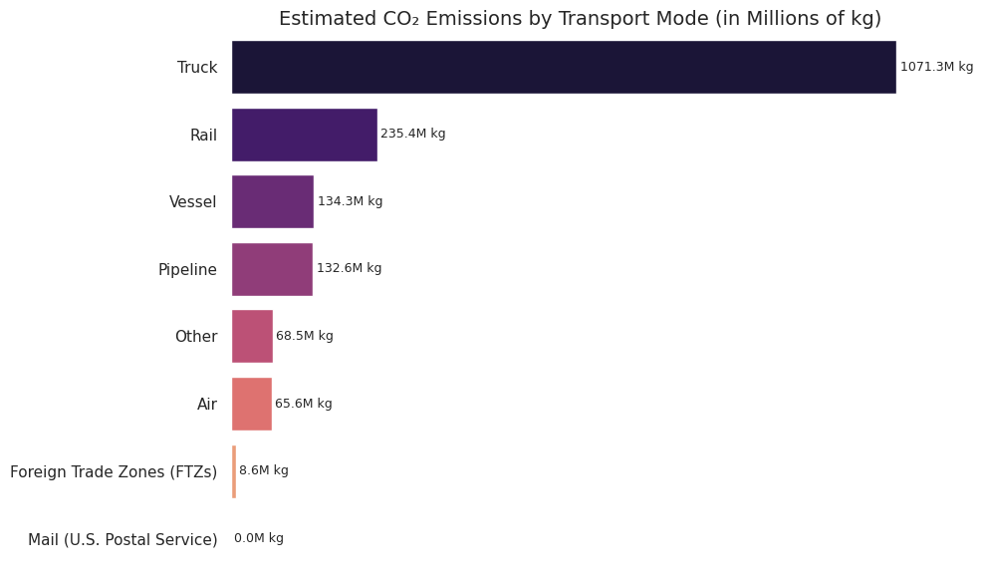
06
Environmental Impact By Transport Mode
Trucks contributed the highest CO₂ emissions, followed by rail and vessel. Despite lower emissions, air transport remained minor in volume and impact.

Slide 10

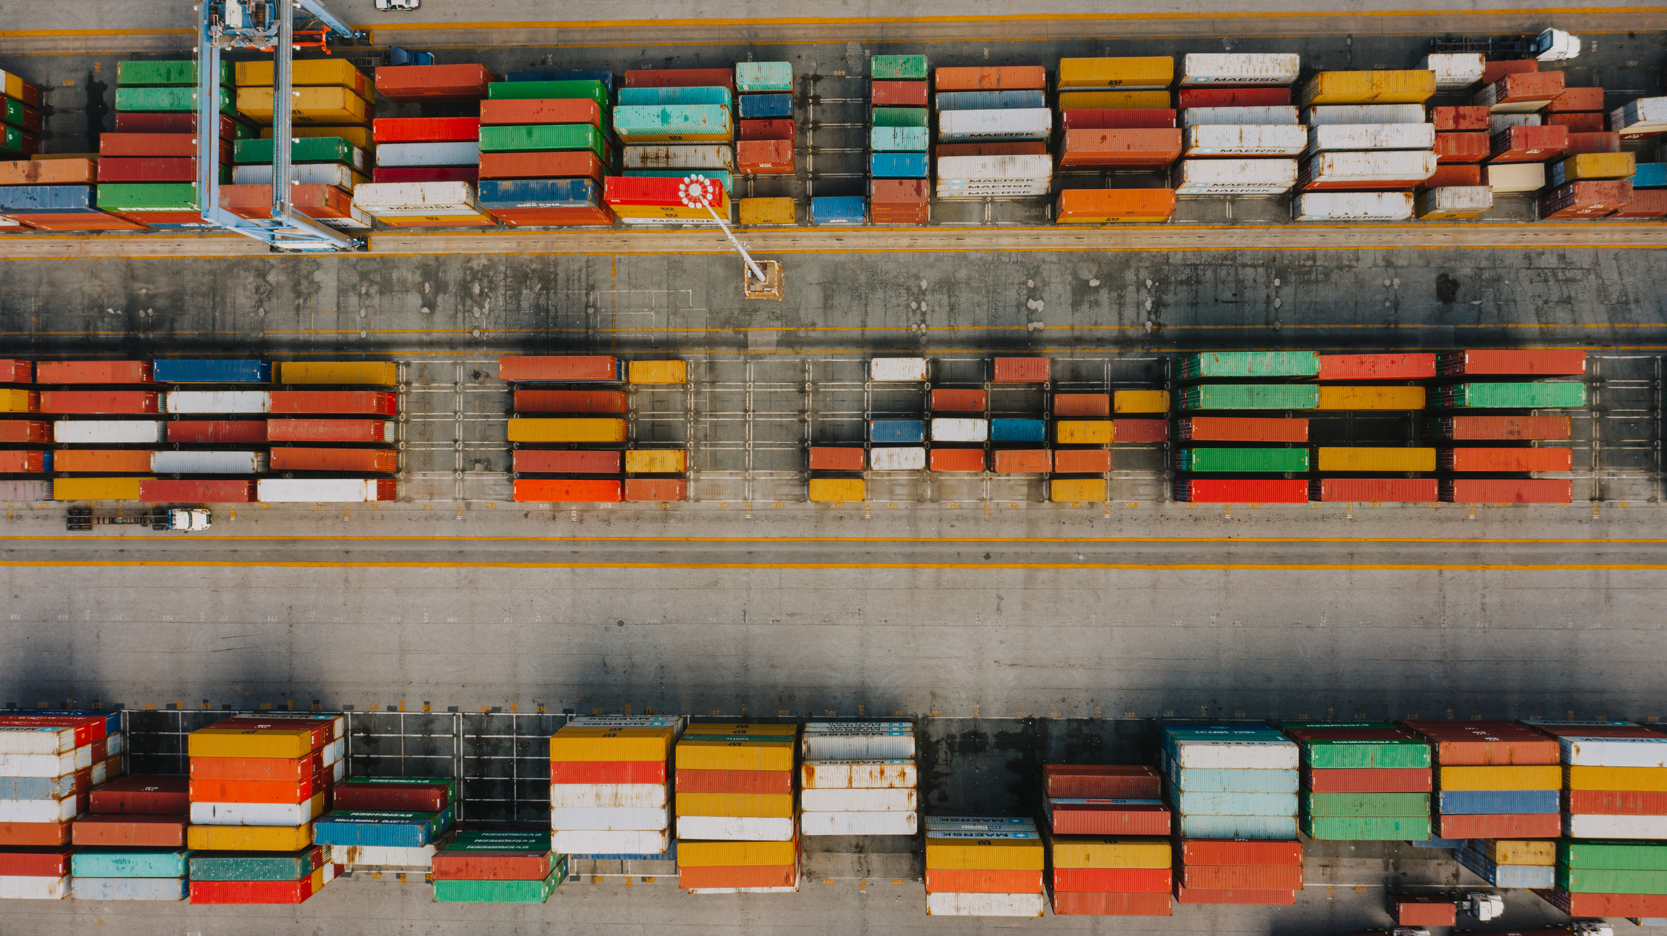
09
Recommendations
Optimize trucking routes and border processing in high-cost states..
Encourage modal shifts to lower-emission transport (rail, vessel) for long hauls.
Monitor peak months to support infrastructure planning and staffing.

Slide 11

04
Tools Used
Python (Pandas, Matplotlib, Seaborn)
Google Colab
GitHub (for version control & collaboration)

Slide 12
Conclusion
This analysis highlighted critical trends and inefficiencies in U.S. transborder trade with Canada and Mexico. It empowers BTS with data-backed insights to optimize freight systems and improve sustainability. The findings serve as a foundation for strategic planning, infrastructure investment, and greener transportation practices.

